Slide 1
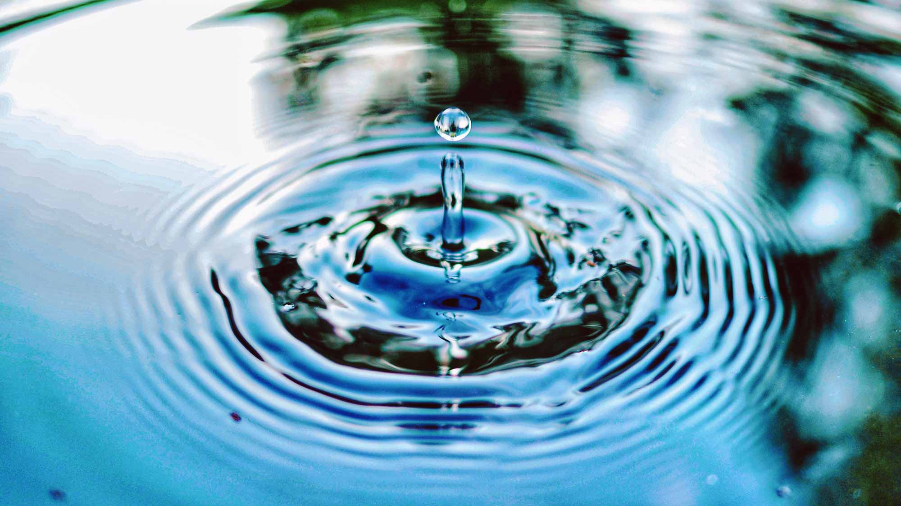
Water
Geography: Water
What are the three states of matter?
What are the key aspects of the water cycle?
How are clouds formed?
How and why is drinking water cleaned?
What are the causes and effects of flooding?
What are the causes and effects of water pollution?
Science:
- Identify and describe the functions of different parts of flowering plants: roots, stem/trunk, leaves and flowers
- Explore the requirements of plants for life and growth and how they vary from plant to plant
- Investigate the way in which water is transported within plants
- Explore the part that flowers play in the lifecycle of flowering plants, including pollination, seed formation and seed dispersal
Computing: Computer systems and networks: The Internet
Understanding networks and the internet
Sharing information
Who owns the web?
PE:
Music: ‘March’ from The nutcracker
Develop active listening skills by responding to musical themes through movement.
Understand the structure of rondo form (A-B-A-C-A).
Develop a sense of beat and rhythmic pattern through movement.
PSHE:
Don’t hold on to what is wrong!
Exploring positive and negative feelings.
Talking through scenarios around forgiveness.
Martins, Term 4
Art/DT: Mechanical Systems
Building prototypes of mechanical cars and evaluating their effectiveness.
English
Key Texts: The Ice Palace, Robert Swindells
Setting description: exploring metaphors and figurative language for winter landscapes, creating a setting description for Ivan’s land (based on class text)
Recount, writing as Ivan: writing a recount as a character, using first person and understanding a character’s perspective, Vary sentence openers by changing the pronoun.
Narrative, telling Starjik’s story: Describing plot and characters accurately, using a range of sentences, organizing ideas into paragraphs.
Mathematics
Mass and capacity
Measuring and converting between grams and kilograms
Measuring in milliliters and liters.
Comparing mass, capacity and volume.
Recognising equivalent measurements.
Fractions
Add and subtract fractions and mixed numbers
Calculating fractions of an amount
RE:Why do Christians call the day Jesus died ‘Good Friday’?
What is Holy Week?
How do Christians celebrate Good Friday?
Can we see signs of hope in the world today?
What does the bible say about Good Friday?

