Slide 1
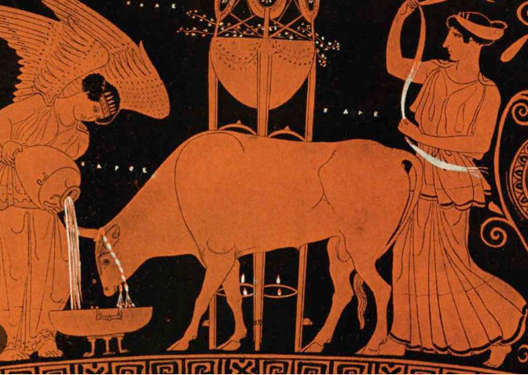
Peacocks- Term 6
The Ancient Greeks

Slide 2
English Writing:
This term our novel will be Mark of the Cyclops by Saviour Pirotta.
We will be using this as a stimulus to write diary extracts and first person narratives.

Slide 3
SPaG:
Year 5: suffixes (-ate, -ise and –ify) to convert nouns/adjectives into verbs; modal verbs
Year 6: active and passive voice; hyphenated words to clarify meaning; synonyms and antonyms; word repetition

Slide 4
Chilham Readers:
In Chilham Readers, we will be practising our VIPERS skills by reading a variety of texts linked to our Ancient Greece and Materials and their Properties topics.

Slide 5
MFL
French:
Look what I can do!
When I grow up
How do you spell that?
How are you feeling?
What am I going to do?
Je me presente…

Slide 6
Art and Design:
Drawing: Exploring tone, texture and proportion
Create a 3D effect
Combine lines and marks to represent textures
Dark and light areas
Compare sizes of objects
Consider placementof elements
Use impasto techniques to create texture

Slide 7
Computing:
Searches and Searching:
Computers can be connected together to form systems
Recognise the role of computer systems in our lives
Experiment with search engines
Describe how search engines select results
Explain how search results are ranked
Recognise why order of results is important

Slide 8
History
This term our History topic is Ancient Greece
Who were the Ancient Greeks?
What was daily life like in Ancient Greece?
How did life in Athens compare with life in Sparta?
What did the Ancient Greeks believe?
What did the Ancient Greeks believe about the Trojan War?

Slide 9
Maths
Topics this term will include:
Place value to 10,000,000, coparing, ordering and rounding numbers, and negative numbers
Addition and subtraction, including using known facts
Multiples, factors and prime numbers, and multiplying and dividing by 10, 100 and 1000

Slide 10
RE
What does it mean if Chrisitans believe God is Holy and Loving?
What do Christians believe God is like?
What does the Bible say about God?
What does God hate?
What is the sacrament of penance or confession?

Slide 11
PE
Invasion Games (Handball)
Different types of passing and shooting
Basic dribbling
Linking dribbling and passing
Linking dribbling and shooting
Decision making: pass, take 3 steps or dribble?
To use all learnt skills in a game

Slide 12
Science
Properties and Changes of Materials
Classify and group materials by their properties
Compare materials for thermal insulation
Investigate materials for electrical insulation or conductivity
Investigate the solubility of a range of materials in water
Separate mixtures using magnetism, sieving and evaporation/filtration
Explain the differences between reversible and irreversible changes

Slide 13
PSHE
Get into Heartsmart
How can we communicate opinions with respect?
How can body language help us feel more powerful?
Keeping our hearts soft but strong
When is it right to keep a secret? When should a secret be shared?
Marriage is a commitment of two people to eachother
What is a healthy meal like?
How can we protect our own and eachothers’ hearts?

Slide 14
Music
What Shall We Do With the Drunken Sailor?
Sing a sea shanty expressively
Learn a cup rhythm game
Create body percussion patterns
Create accompaniments with bass notes and chords
Rehearse and perform

