Slide 1
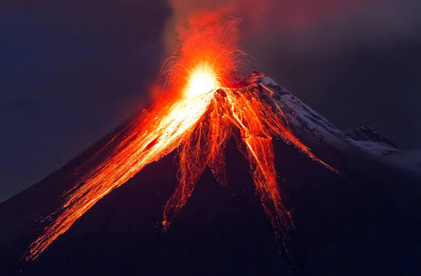

Martins
Martins

Slide 2
Maths
Place Value
(Y2: to 100 / Y3-4: 3&4 digit)
Addition & Subtraction
(Y2: 2-digit / Y3-4: Columnar)

Slide 3
English
Diary
Instructions

Slide 4
Science
Sound
To explore and identify how sound is made by vibrations.
To predict and compare how sounds travel through different mediums.
To investigate patterns between the volume of sound and the vibrations that made it.
To investigate patterns between the pitch of a sound and variations in the sound source.
To carry out an investigation to find the relationship between the volume of sound and distance from the sound source.
To research and investigate the best sound insulator.

Slide 5
RE
Creation
Who made the world?
What do Christians learn from the creation story?

Slide 6
Topic
Extreme Earth (G) (Volcanoes)
What is a volcano?
Why do volcanoes erupt?
Where in the world
Dangers and benefits of volcanoes
Living near a volcano

Slide 7
PE
Football
Dribbling
Passing
shooting

Slide 8
French
Getting to know you
Hello!
What’s your name?
How are you?
Goodbye!
Counting 0-10
How old are you?

Slide 9
Art & DT
Drawing
Understanding Tone

Slide 10
Computing
Systems (Y2)
IT Around Us

Slide 11
Music
Orchestra
The Carnival of the Animals

Slide 12
PSHE
Get Heart Smart – 2
Ways to show love to ourselves and others in person and online
How to be positive or negative to one another
How to recall memories and to associate a feeling to the memory
How to guard your heart
Being grateful for the people around us
The benefits of a healthy life-style and dangers of an unhealthy life-style

